Slide 1
ONLINE BOOK STORE APPLICATIONS
Submitted By,
Mrs.Amritha
Mrs.Sharmila
Ms.Sandhiya
Ms.padmavathi
Ms.Malathi
Batch No:7398
Under the Guidance of
Trainer Mrs.Indrakka Mali

Slide 2
CONTENTS:
Introduction
Objective
Software requirements
System overview and snapshots
Conclusion.

Slide 3
INTRODUCTION:
The project “Online book store application” is developed using SpringBoot Framework .
In this online book store application is used to Entity ,Controller,Repository,Service classes by using springboot framework.
It is an online web application where the customer can purchase books online. Which is mainly focuses on web browser that customer can search for a book by its title or author. we used inserting, deleting, updating and getting all information in this online bookstore application itself.

Slide 4
Author Module:
In the Author module we can perform :
We can add new records.
Fetch customer record by author id.
Fetch all customer records.
Fetch all book records.
Fetch all author records.
Fetch all publisher records.

Slide 5
Books Module:
In the Books Module we have book Id, Title, ISBN, Genre and Price.
We can register books by using Book Id.
Books can easily add, update, delete by using book service.

Slide 6
Customers Module:
In Customers Module we have Customer Service.
New customers can get registered using Customer Id.
In customer details we have first name, last name, customer address and phone number and email id.

Slide 7
Orders Module:
In orders module we get the orders by checking orderById and date of the Order we ordered.
Publishers Module:
We get the publication details by PublisherId and PublicationName

Slide 8
Objective:
It provides “better and efficient” service”.
Faster way to get information about the Authors, Books, Customers, Orders and Publishers.
Provide facility for proper monitoring and reduce paper work.
All details will be available on a click.

Slide 9
System Overview
The Online Book Store Application will be automated the traditional system.
There is no need to use paper and pen.
Checking a student details is very easy.
Adding new student record is very easy.
Deleting or updating a record of a particular student is simple.

Slide 10
Requirements:
Software Requirement:
Database: MySQL
Dependencies: API- Spring Data JPA
Spring web, Spring Boot Dev Tools, Validation, MySQL Driver
Tools: Postman, IDE-Spring Tool Suit4 Coding language-Java 1.8
Hardware Requirements:
RAM: 2GB
Processor: 64bit Memory: 512 MB Disk Space: 100GB

Slide 11
Spring Tool Suit:
STS is an Eclipse-based development environment that is customized for the development of spring applications.
It provides a ready-to-use environment to implement, debug, run and deploy your applications.
Postman:
Postman is a standalone software testing API (Application Programming Interface) platform to build, test, design, modify, and document APIs. It is a simple Graphic User Interface for sending and viewing HTTP requests and responses.
MySQL:
MySQL is a relational database management system
MySQL is open-source
MySQL is free
MySQL is ideal for both small and large applications
MySQL is very fast, reliable, scalable, and easy to use
MySQL is cross-platform

Slide 12
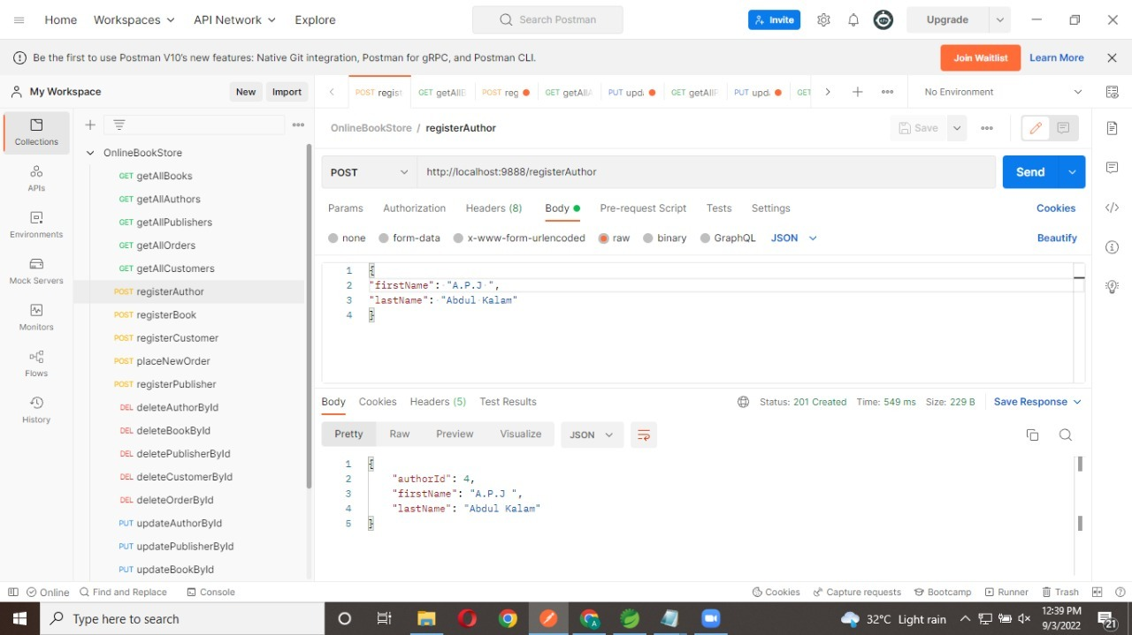
Screenshorts:

Slide 13
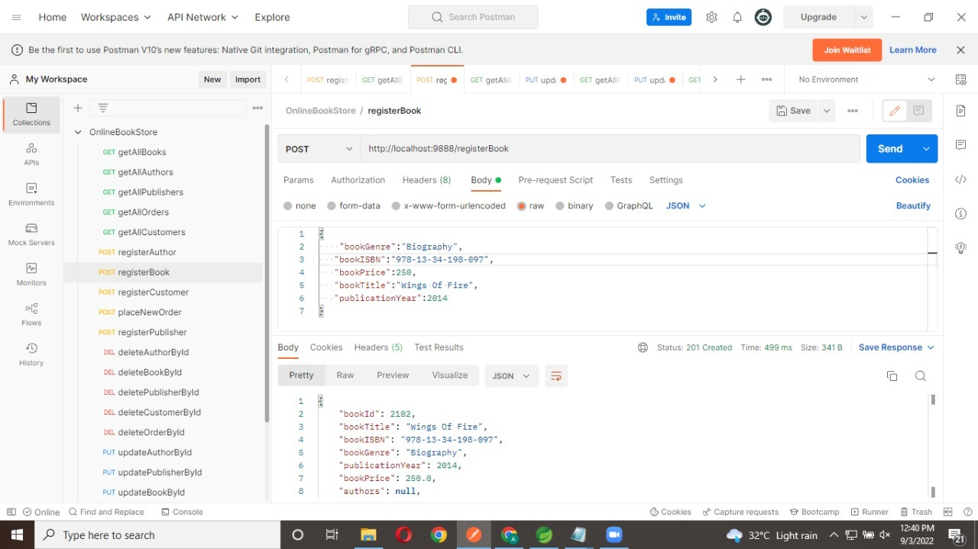
Step2:

Slide 14
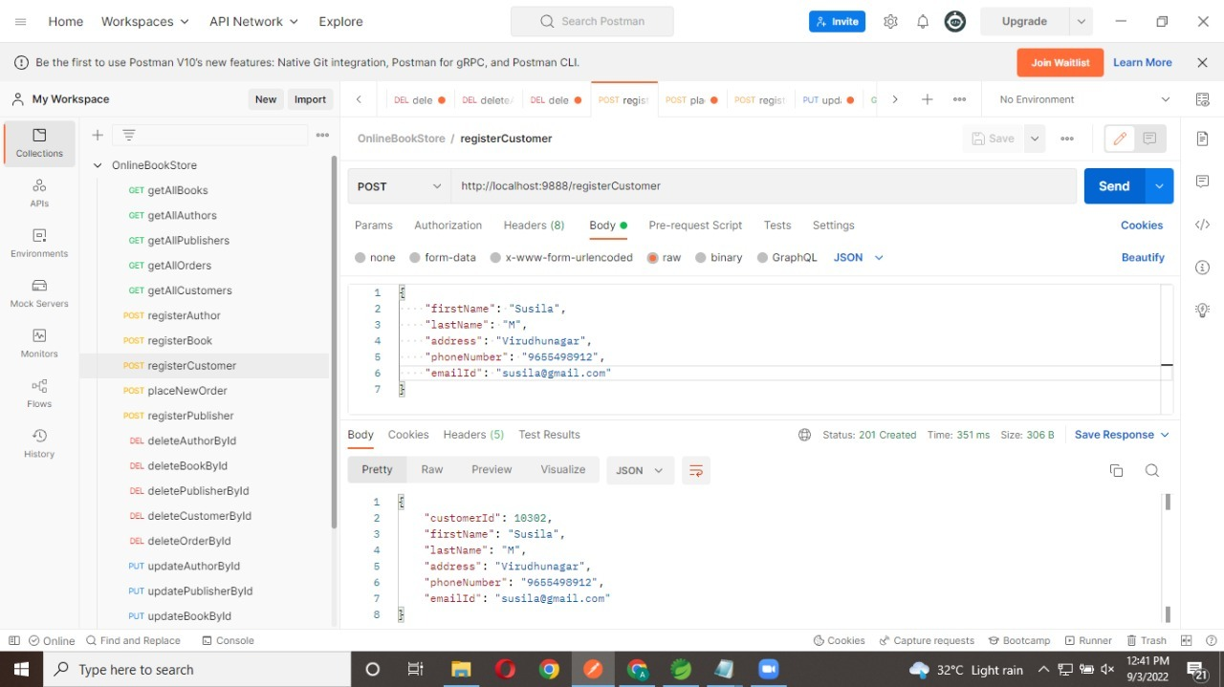
Step3:

Slide 15

Step 4:

Slide 16
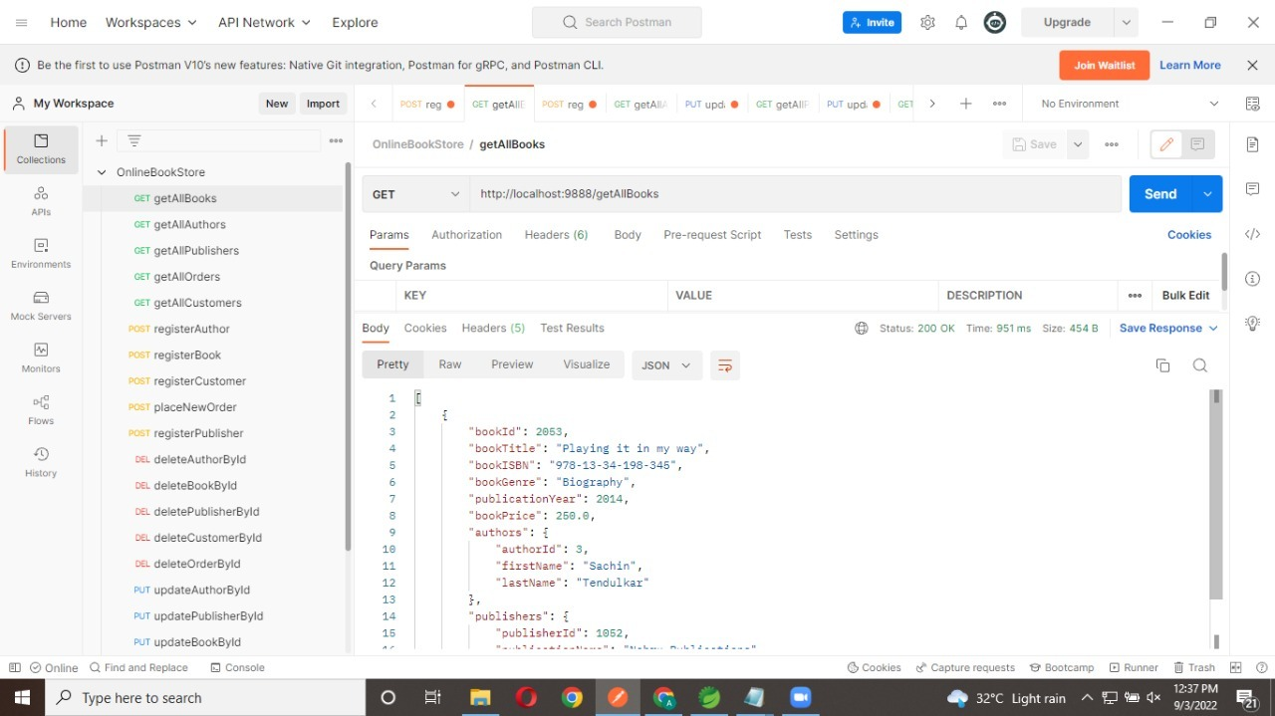
Step5:

Slide 17

Step6:

Slide 18

Step7:

Slide 19
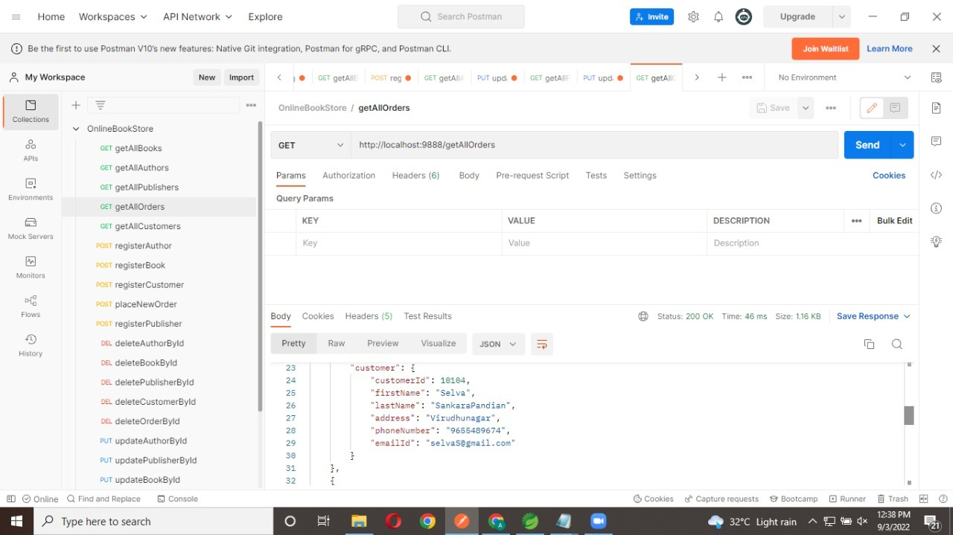
Step8:

Slide 20

Step9:

Slide 21
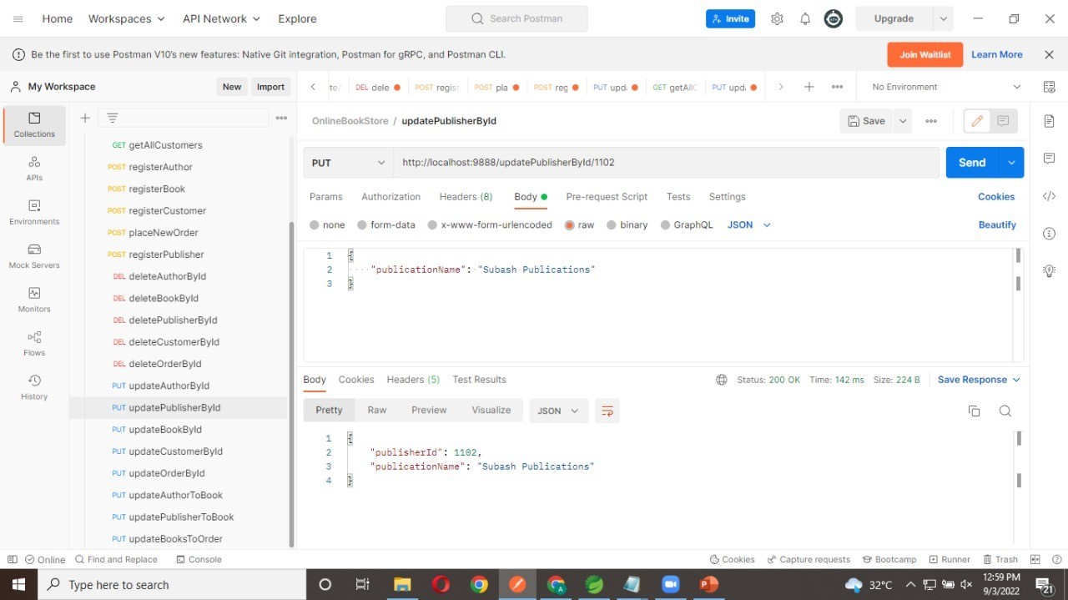
Step10:

Slide 22
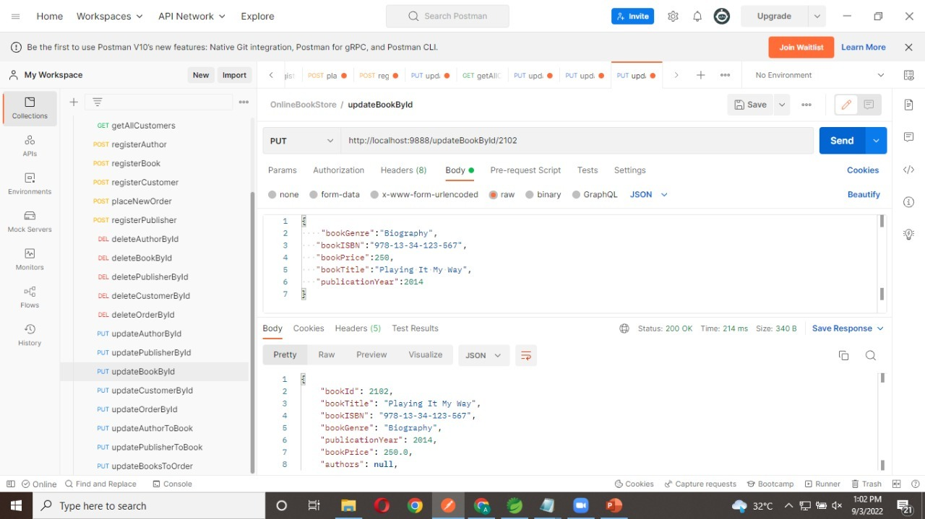
Step11:

Slide 23

Step12:

Slide 24

Step13:

Slide 25
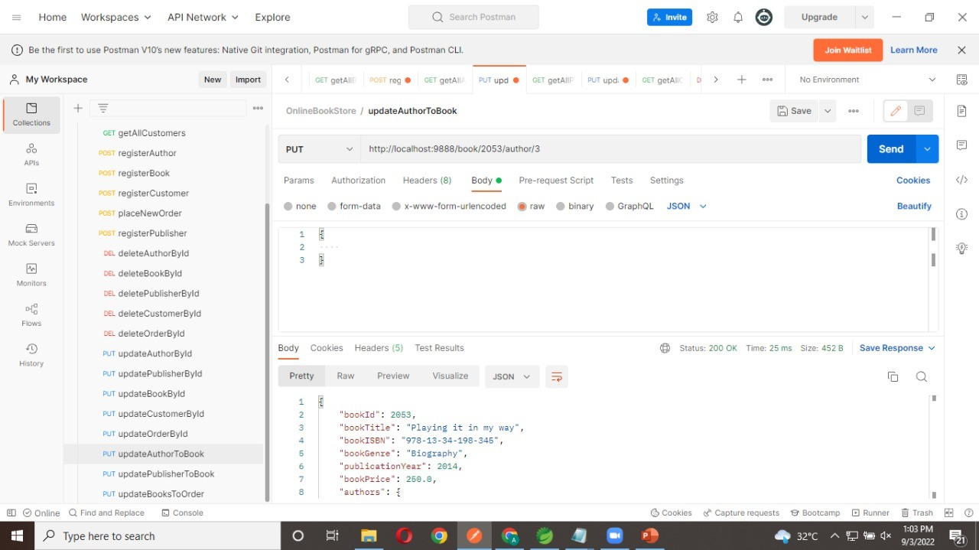
Step14:

Slide 26

Step15:

Slide 27

Step16:

Slide 28
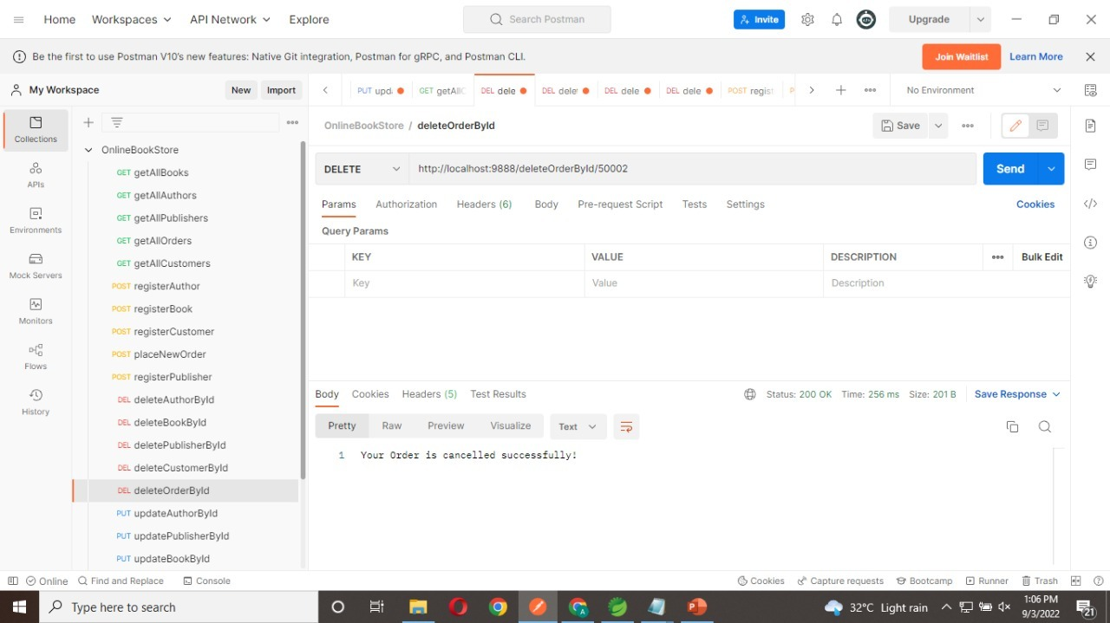
Step17:

Slide 29
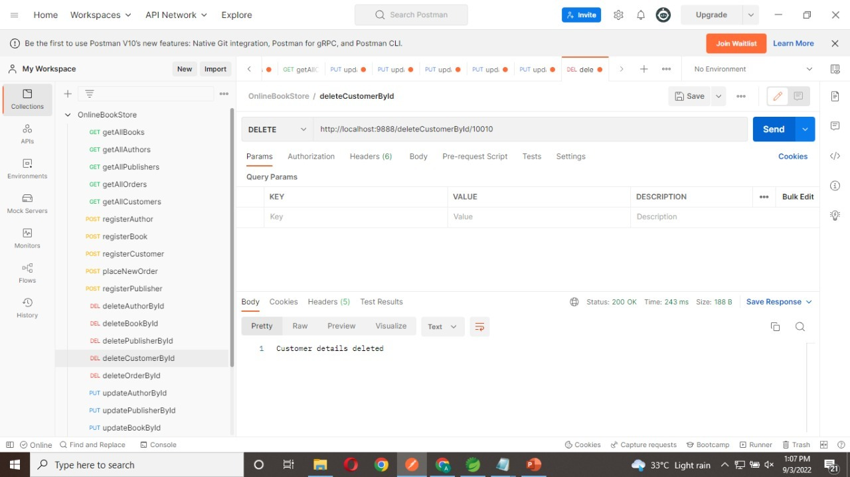
Step18:

Slide 30
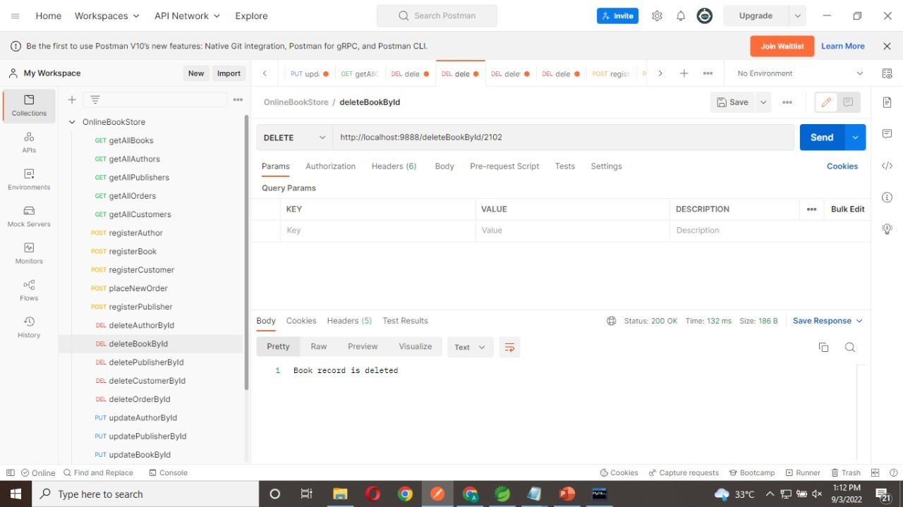
Step19:

Slide 31
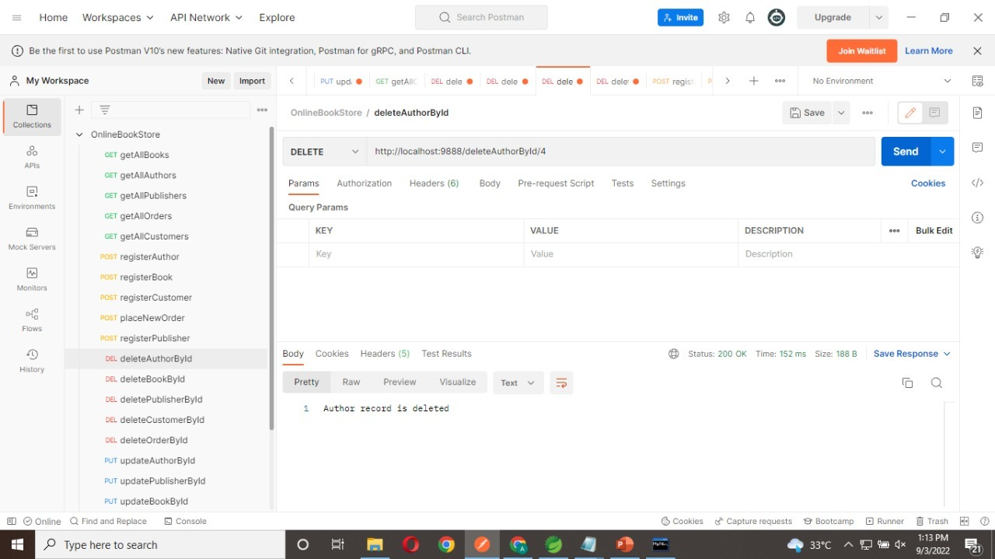
Step20:

Slide 32
Step21:

Slide 33
Annotations:
1.@Service:
We mark beans with @Service to indicate that they're holding the business logic. Besides being used in the service layer, there isn't any other special use for this annotation.
2. @Repository:
The @Repository’s job is to catch persistence-specific exceptions and re-throw them as one of spring’s unified unchecked exceptions.
3. @RestController:
The @RestController annotation is a convenience annotation that is itself annotated with @Controller and @ResponseBody.It is used to create RESTful web services using Spring MVC. Spring Rest Controller takes care of mapping request data to the defined request handler method.

Slide 34
4. @Autowired:
The spring framework enables automatic dependency injection. In other words, by declaring all the bean dependencies in a spring configuration file, Spring container can autowire relationships between collaborating beans. This is called spring bean autowiring.
5. @GetMapping:
The @GetMapping annotation is a specialized version of @RequestMapping annotation that acts as a shortcut for @RequestMapping (method = RequestMethod.GET).
6. @PostMapping:
The @PostMapping is specialized version of @RequestMapping annotation that acts as a shortcut for @RequestMapping (method = RequestMethod.POST). The @PostMapping annotated methods in the @Controller annotated classes handle the HTTP POST requests matched with given URI expression.

Slide 35
.
7. @PutMapping:
The @PutMapping is used to update/modify the resource so the @PutMapping annotation is used for mapping HTTP PUT requests onto specific handler methods. Specifically, @PutMapping is a composed annotation that acts as a shortcut for @RequestMapping (method = RequestMethod.PUT).
8.@DeleteMapping:
The @DeleteMapping annotation maps HTTP DELETE requests onto specific handler methods. It is a composed annotation that acts as a shortcut for @RequestMapping (method = RequestMethod.DELETE).
9.@OneToMany:
A one-to-many relationship between two entities is defined by using the @OneToMany annotation in Spring Data JPA. It declares the mappedBy element to indicate the entity that owns the bidirectional relationship. Usually, the child entity is one that owns the relationship and the parent entity contains the @OneToMany annotation.

Slide 36
11.@generatedValue:
Marking a field with the @GeneratedValue annotation specifies that a value will be automatically generated for that field. This is primarily intended for primary key fields but Object DB also supports this annotation for non-key numeric persistent fields as well.
12.@entity:
The @Entity annotation specifies that the class is an entity and is mapped to a database table. The @Table annotation specifies the name of the database table to be used for mapping. Database Table
13.@one to one:
One-to-One relationship in JPA, each entity instance is related to a single instance of another entity. It means each row of one entity is referred to one and only one row of another entity.
14. @Many to Many:
A relationship is a connection between two types of entities. In the case of a many-to-many relationship, both sides can relate to multiple instances of the other side.

Slide 37
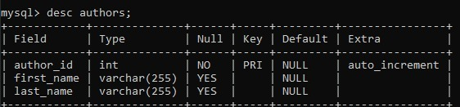
Database Table Design:
Authors table:

Slide 38
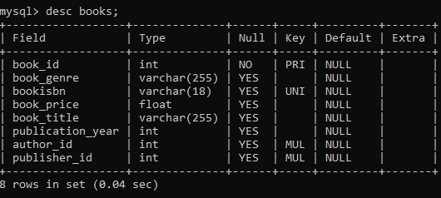
Books Table:

Slide 39
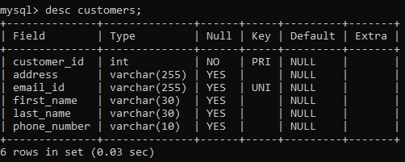
Customers Table:

Slide 40
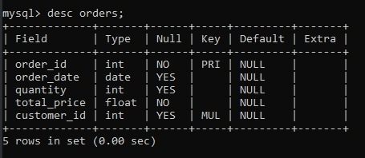
Orders Table:

Slide 41
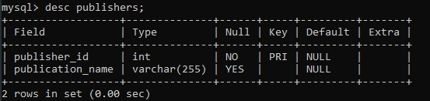
Publishers Table:

Slide 42
CONCLUSION:
Online Bookstore Application makes customer jobs more accessible by giving them an easy place to find and sort information.

Slide 43
Thank you..!

